Slide 1
Bloom 101
An Introduction to the Bloom Protocol

Slide 2


About Me
Head of Community & Developer Relations
Previously:
Research Analyst at Info-Tech Research Group
Linux System Administrator
Owner/Operator of CleverHost

Slide 3
What is the Bloom protocol?

Slide 4
Bloom is a solution for secure decentralized/digital identity and credit. Bloom provides consumers with a secure method to authenticate identity and financial information without exposing personal information. By decentralizing information sharing between untrusted parties, the system reduces risk of identity theft. With Bloom individuals own and control their data.

Slide 5
Bloom Protocol
Bloom is not a lender; rather a platform for lenders to determine the credit worthiness of an individual
Solutions for identity fraud & cross-border credit scoring
Protocol is made up of three keystones:
BloomID
BloomIQ
BloomScore
All smart contract code is open-sourced after a security audit.

Slide 6
BloomID

Slide 7
BloomID is a decentralized identity that allows you to verify your data in a secure way on the Ethereum blockchain

Slide 8
BloomID
Mobile & Web Application available for users to verify data
Phone number > Confirmation Code
Photo ID > Third-party attester
Income > Third-party attester
Data not stored on the blockchain
The attestation that the data has been verified is stored on the blockchain
Data is encrypted using a user's private keys and stored using a secure mechanism (e.g. vault)

Slide 9
BloomID
Mobile & Web Application available for users to verify data
Phone number > Confirmation Code
Photo ID > Third party attester
Data is stored not stored on the blockchain
The attestations that the data has been verified is stored on the blockchain
Data is encrypted using a users private keys and stored on the user’s local device
Sharing Data
Control over when to share data, what data to share, what level of detail and for how long

Slide 10
BloomID is meant to put the control of the user’s data back in the hands of the user.
Control over when to share, what to share, and what level of detail.

Slide 11
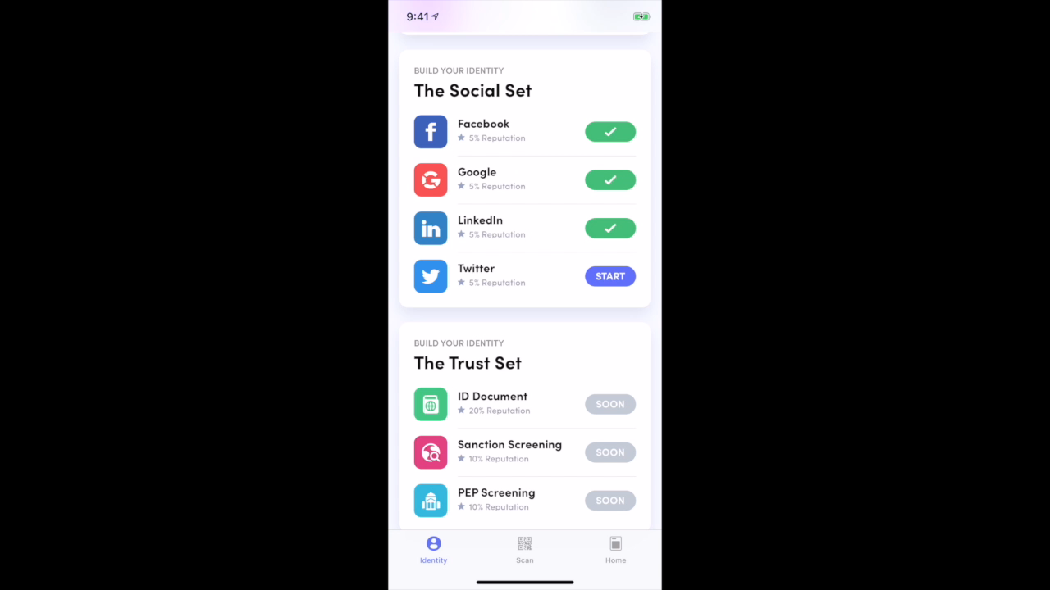

Slide 12
BloomID FAQ

Slide 13
How do you update your data tied to your BloomID?
While data can’t be deleted from the blockchain, it is possible to delink an attestation from a particular BloomID.

Slide 14
What happens if a user loses their mobile device?
Still to be decided. Several options such as:
Recover the BloomID and its attestations using a pre-nominated trusted circle of friends
All attestations become invalid and the user starts over with a new BloomID
User selects which attestations to be made invalid based on what they believe to be compromised

Slide 15
BloomIQ

Slide 16
BloomIQ is an open-source risk assessment framework built using a variety of different inputs such as research done by the Bloom Economic Research Division (BERD) and community inputs.

Slide 17
BloomIQ
Analogous to large credit bureaus like Equifax & Transunion
Entire risk assessment framework is open-source & fully transparent
Will incorporate other signals into calculating the credit score
Utility Bill Payments
Rent Payments
Cellphone Bills
Cryptocurrency holdings
Other inputs like employment history, level of income etc.

Slide 18
Attestors
Bloom will work with attesters to determine the validity of utility bill payments and prior credit history
A person or organization who attests the genuineness of a document or signature

Slide 19
BloomScore

Slide 20
A user-specific credit score that is calculated using the user’s BloomID & BloomIQ. Serves as a better alternative to the scores generated by companies like Equifax, Transunion & FICO.

Slide 21
BloomScore
Intelligent enough to account for individuals at different stages in life
Different caps at different ages
A more inclusive credit score
Lenders determine their risk appetite
The algorithm used to calculate score will be open-sourced

Slide 22
Bloom Token [BLT]

Slide 23
Bloom Token is an ERC-20 token and is required to participate in the Bloom protocol.

Slide 24
Bloom Token [BLT]
Required to participate in the protocol
Voting on protocol decisions
Paying for attestations

Slide 25
Bloom Token [BLT]
Required to participate in the protocol
Voting on protocol decisions
Paying for attestations
Moving forward
The role of the Bloom Token will evolve as the protocol evolves

Slide 26
Use Cases Beyond Finance

Slide 27
Use Cases
On-chain record of family relationships
eg. Marriage contract, parental verification
Verification for dating apps
eg. Sergei has a verified name, phone number and date of birth on his BloomID
Educational history
Verified degree from SAIT via Odem, or Oxford University

